Slide 1
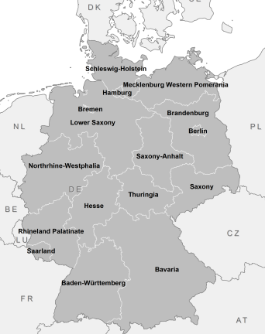
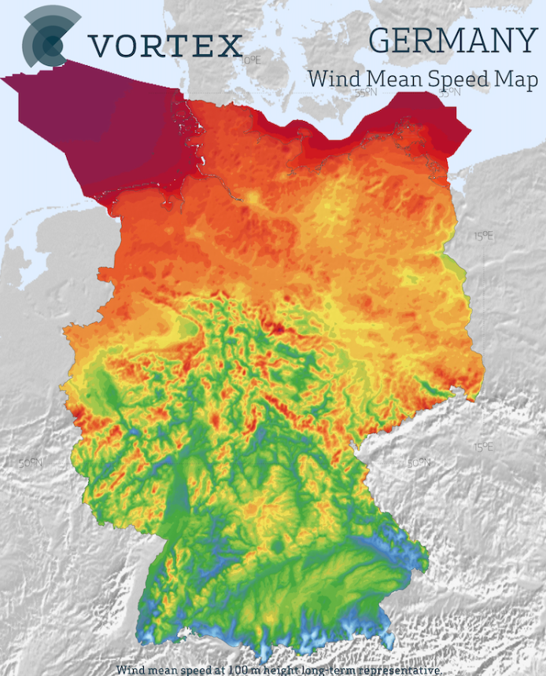
Wind Onshore & Wind Offshore
Heat-Map of Wind Speed in Germany
It therefore makes sense to build out most wind farms in the north.
States with largest installed Onshore capacities:
Lower Saxony: ~12.542 GW
Schleswig‑Holstein: ~8.549 GW
Brandenburg: ~8.662 GW
As of end-2024, ~ 63 GW of installed onshore wind capacity.
States with largest installed Offshore capacities:
Lower Saxony: ~ 5.3 GW
Schleswig‑Holstein: ~ 2.1 GW
Mecklenburg‑Vorpommern: ~ 1.1 GW
As of end-2024, ~ 9 GW of installed offshore wind capacity.

Slide 2
Onshore forecasts are higher and more variable due to larger installed capacity and the model’s scaling with available infrastructure.
Germany’s onshore wind capacity is more than 6 times its offshore capacity !
Offshore forecasts stay lower and steadier, reflecting smaller capacity and more consistent marine wind conditions.
Wind Onshore generation is highly volatile, with a daily standard deviation of around 3 GW, occasionally reaching up to 12 GW during peak fluctuations.
Fun Fact:
A single large wind turbine can power over 1,500 homes for a year — and the blades on modern offshore turbines can be longer than a football field, sweeping an area larger than the London Eye.

Slide 3
2021 marked a record low in wind generation, caused by unusually calm weather across Central Europe. Despite ongoing capacity expansion, the reduced wind speeds led to noticeably lower forecasted output.
The impact extended into early 2022, when weaker winds persisted before conditions normalized later in the year, moderating overall generation levels.
From 2023 onward, both onshore and offshore forecasts recovered steadily, reflecting a return to typical wind patterns and continued growth in installed capacity.
Wind generation is usually highest in winter months (Jan–Mar, Nov–Dec) due to strong North Sea winds and frequent storms.
It’s typically lower in summer (May–Aug) when conditions are calmer.
Wind generation is usually highest in winter months (Jan–Mar, Nov–Dec) due to strong North Sea winds and frequent storms.
It’s typically lower in summer (May–Aug) when conditions are calmer.

